Slide 1
GENERATIVE AI · FINAL PROJECT
SummarAI
Turn any meeting into structured, searchable memory then ask an AI agent about it.
DECISION
Public launch delayed one week for performance testing
Prioritise API latency fix
@Marco
Thursday
faster-whisper
claude-haiku-4-5
gemini-embedding-001
pgvector
FastAPI
Notes:
SPEAKER 1 — opening (~25s). We're Group 3. SummarAI turns any meeting into structured records — decisions, notes, owned action items — and then lets you ASK an agent across all of them. Those tagged rows are the actual product output; you'll see them live. Straight into the problem.

Slide 2

BUSINESS CASE
Meetings cost more after they end.
72%
of professionals call meetings unproductive
Where existing tools stop
Otter, Fireflies, Copilot, Zoom: one transcript per meeting
4 in 10
action items actually get followed up
No decision vs note distinction
≈85 hrs
a 5 person team loses per year re-reading notes
Action items attributed unreliably
No memory across meetings you can't query history
The cost isn't the meeting it's the re-discovery of decisions that were already made.
Cross-meeting tools that exist are closed, costly SaaS
Our niche: cross-meeting memory + action accountability, on an open stack.
SummarAI
Notes:
SPEAKER 1 (~45s). Meetings eat the week, and their value leaks the moment the call ends: decisions misremembered, action items dropped. A 5-person team loses ~85 hours a year just re-reading notes. Tools like Otter or Copilot give you one transcript per meeting — none let you query across your whole history with accountability. That gap is our niche.

Slide 3
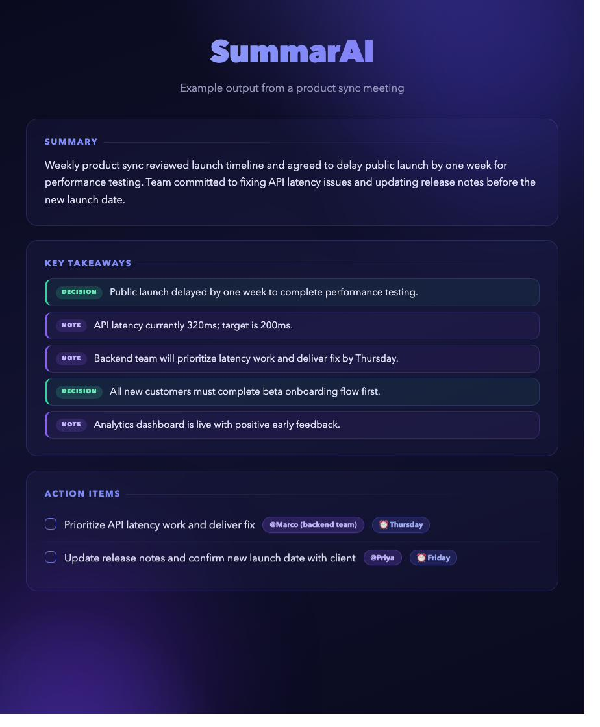
THE PRODUCT
Two moves: summarise, then ask.
01
Summarise a meeting
Upload audio or paste a transcript. The outcome: a 2-sentence summary, key takeaways tagged decision or note, and action items with owner and deadline.-> --> only when actually said
02
Ask across every saved meeting
“What's overdue?” · “Who owns the design task?” · “Draft a recap.” A single agent answers from the archive grounded in real meetings and cited, never guessed.
SummarAI
Notes:
SPEAKER 2 (~40s). Two moves. One: summarise — schema-validated summary, takeaways split into decisions vs notes, owned action items. Two, the course piece: ask. Once meetings accumulate you query them in plain language and an agent answers from the archive with citations. The screenshot is real output. Next, how it's wired together.

Slide 4

MVP INTEGRATION
One backend, wired end to end.
local ASR
faster-whisper
Browser SPA
FastAPI
summarise + agent
HTML + JS
one app: JSON API + the UI
claude-haiku-4-5
fetch
vectors
gemini-embedding
Every action -> upload, save, ask -> is a real fetch with live results.
no mocks
store + search
Supabase · pgvector
live trace
The Ask panel streams the agent's tool-call trace as it runs.
single deploy
One process serves the API and the page: nothing hardcoded.
SummarAI
Notes:
SPEAKER 2 (~40s). It's deliberately simple: one FastAPI app serves both the JSON API and the single-page UI. The browser talks to it with plain fetch calls; the backend fans out to local Whisper, Claude Haiku, Gemini embeddings, and Supabase with pgvector. Nothing is mocked — upload, save and ask are all live, and the Ask panel streams the agent's trace so you can see the integration working. Hand to [Speaker 3] for the pipeline.

Slide 5

TECHNICAL DEPTH
From raw audio to structured records.
1
2
3
4
5
Audio / video
Whisper ASR
Transcript
Claude Haiku
3 fields
.mp4 .mp3
.wav .m4a
base.en · int8
local CPU
plain text
≤ 300K chars
structured
JSON schema
summary · takeaways
action items
Preprocessing: VAD silence removal · int8 quantization · multithread decode. Bypass: a text transcript (.txt .md .vtt .srt) skips the ASR stage entirely.
The transcript can be huge, so the schema-constrained Haiku call does the structuring —> not a brittle regex pass.
SummarAI
Notes:
SPEAKER 3 (~35s). The pipeline: audio in, faster-whisper transcribes locally with int8 on CPU, the transcript (up to 300K chars) goes to Claude Haiku, which returns structured JSON — summary, tagged takeaways, owned action items. If you already have a text transcript it skips transcription entirely. The structuring is done by a schema-constrained model call, not fragile string parsing.

Slide 6
TECHNICAL DEPTH
Prompt engineering: structure, not hope.
summarisation prompt
RAG prompt
summary → at most 2 sentences key_takeaways → comprehensive, tagged decision | note action_items → owner + deadline only if stated · never invent
use ONLY the provided <context> cite the meeting title(s) used if not in context → say “not found” do not guess or hallucinate facts
schema-locked
Output is constrained to a JSON shape at the API level, so it always parses.
null > guess
owner / deadline stay null when unstated -> we never misattribute a task.
haiku 4.5
Transcription is the bottleneck, not summarising -> a bigger model adds cost, not value.
SummarAI
Notes:
SPEAKER 3 (~40s). Two prompts, both engineered for control. The summariser forces a 2-sentence summary, comprehensive takeaways tagged decision or note, and owners only when actually said — never invented. The RAG prompt is strict grounding: use only the retrieved context, cite the meeting, and say 'not found' rather than guess. Output is schema-locked so it always parses, and we use Haiku 4.5 on purpose — transcription is the slow part, so a bigger model would just cost more.

Slide 7
TECHNICAL DEPTH
We optimised the slow part.
transcription time · same 20-min file
Four levers
470s
base.en
−72%
English-only model -> faster and more accurate
beam_size=1
zero accuracy loss
36,620 vs 36,702 chars
greedy decoding -> ~2× faster, near-zero quality loss
132s
cpu_threads
use all cores vs the library default
language='en'
skip auto-detection -> one less pass
original
optimised
End to end: 3.5× faster on a 20-min file (7:50 → 2:12).
SummarAI
Notes:
SPEAKER 3 (~40s). Transcription was the slow part, so we engineered it: 470 seconds down to 132 on the same 20-minute file — a 72% cut with zero accuracy loss, character counts basically identical. Four levers: the English-only base.en model, greedy decoding, all CPU cores, and skipping language detection. End to end that's 3.5× faster. Over to [Speaker 4] for retrieval and the agent.

Slide 8
TECHNICAL DEPTH
Ask across the whole archive.
on save
summary text
Gemini embed
pgvector
flattened record
retrieval_document
vector(1536)
on ask
question
Gemini embed
cosine top-3
Claude grounds
natural language
retrieval_query
HNSW · <=>
cited answer
answers carry source chips
Product sync · Mar 14 · 0.87 similarity
RAG over fine-tuning. There's no labelled dataset to fine-tune on; embeddings update the instant a meeting is saved, and running a vector search is far cheaper than retraining.
SummarAI
Notes:
SPEAKER 4 (~45s). Retrieval is classic RAG with one nice detail. On save, each summary is embedded with Gemini using the retrieval_document task type and stored in pgvector as a 1536-dim vector with an HNSW cosine index. On a question, we embed with retrieval_query — the asymmetric task types matter — do a cosine top-3, and Claude grounds its answer in those, returning source chips with title, date and similarity. We chose RAG over fine-tuning: no labels needed, instant updates, far cheaper.

Slide 9

TECHNICAL DEPTH
A single tool-using agent.
question
Claude + 5 tools
execute tool
feed result back
grounded answer
user
decide
backend
≤ 5 rounds
+ trace
loops back ↺
The fixed toolbox
search_meetings
semantic RAG over the archive
“One agent, one loop, a fixed toolbox, a step cap.”
get_meeting
pull one full saved record
list_action_items
across the project
Multi-agent orchestration adds coordination overhead and hand-off failures that are hard to defend live. Every capability we need is a tool the one agent calls.
find_overdue_action_items
real ISO dates only
draft_followup
a recap / reminder
SummarAI
Notes:
SPEAKER 4 (~45s). The agent is deliberately a SINGLE tool-using agent. A question comes in; Claude picks from five tools, the backend runs it, the result feeds back, and it loops — capped at five rounds. The tools: semantic search, get one meeting, list action items, find overdue, draft a follow-up. We rejected multi-agent on purpose: orchestration adds coordination failures that are hard to defend in a demo. One agent, one loop, fixed toolbox, step cap — explainable.

Slide 10
TECHNICAL DEPTH
Guardrails: anti-loop, anti-hallucination.
Hard step cap. If no grounded answer in 5 rounds, it returns a clear “couldn't reach an answer” —> never an infinite loop.
MAX_AGENT_STEPS = 5
Every tool reads; draft_followup is one bounded generation. Nothing is sent, deleted, or modified —> all reversible.
read-only tools
Every claim must be backed by a tool result; the agent says “not found” rather than guess. Checked by an adversarial eval.
grounded prompt
find_overdue flags only real, parseable dates. “next meeting” is skipped, not fabricated into a deadline.
ISO dates only
SummarAI
Notes:
SPEAKER 4 (~40s). Four guardrails. A hard step cap of five stops runaway loops. All tools are read-only — nothing irreversible can happen. The system prompt forces grounding: back every claim or say 'not found', and we verify that with an adversarial test. And overdue detection only trusts real ISO dates, so it never invents a deadline. That's the rubric's hallucination, security, and agent-loop boxes, ticked. Now the live demo.

Slide 11

Live demo
Notes:
DEMO PRESENTER (~2:00). Switch slide — leave it up and alt-tab to the running app. Script: (1) paste a short meeting, show the tagged summary + owned action items; (2) save it; (3) open Ask: first a grounded question ('what's overdue / who owns X?') so the trace and source chips show; then an out-of-scope question so the guardrail declines instead of inventing. Keep under 2 min. If it breaks, play the backup capture and narrate. Hand to [Speaker 5].

Slide 12

TECHNICAL DEPTH — EVALUATION
Measured with an LLM judge.
Agent -> LLM-as-judge
Agent results
No fixed reference exists for open Q&A, so Claude scores each answer against the agent's own tool-call trace —> the ground truth it actually had. RAGAS-style.
1.00
1.00
faithfulness
answer relevancy
every claim backed by the trace
addresses the question asked
Summariser -> vs humans
30 meetings from the AMI corpus, scored against professional human summaries —> avoiding the circularity of grading an LLM on answers we wrote.
4.5s
100%
avg latency
within step cap
Summariser quality: ROUGE-1 0.335 · action-item recall 42% (28/66), zero-shot from raw audio.
per question, end to end
no runaway loops
Guardrail test passed: the agent declined an ungrounded question instead of hallucinating.
SummarAI
Notes:
SPEAKER 5 (~45s). We evaluated the agent, not the vibes. Because open Q&A has no fixed answer, we used Claude as an LLM judge scoring each answer against the agent's own tool trace — faithfulness and relevancy both 1.0, ~4.5s latency, 100% within the step cap, and the adversarial guardrail question was correctly declined. Separately the summariser scores 0.335 ROUGE-1 and 42% action recall against human AMI summaries.

Slide 13

LIMITS
What it can't do yet and what's next.
Known limits
Roadmap
No speaker labels
HIGH
Speaker diarization
implied ownership → owner left null (the #1 gap)
pyannote.audio between Whisper & Claude —> fixes #1
Misheard names
HIGH
Larger Whisper model
Whisper: “Bojana”→“Janna” → wrong attribution
small.en / medium.en for accents & noise
Overlapping speech
MED
Confidence signals
crosstalk garbles sentences, hurts quality
flag low-confidence items vs. equal certainty
English audio
LOW
Hosted deployment
transcription tuned for English only
long-running FastAPI on Render / Fly.io
Showing the limits —> and a costed path past them —> is part of the technical maturity we want graded.
SummarAI
Notes:
SPEAKER 5 (~35s). We're honest about limits. The biggest is that the transcription has no speaker labels, so implied ownership stays blank, and mishearing names can misattribute a task. Overlapping speech and non-English audio also hurt. The roadmap is prioritised: speaker diarization with pyannote is the top fix, then a larger Whisper model, then confidence signals and hosted deployment.

Slide 14
BUSINESS CASE
The payback is time.
the niche
≈ 85 hrs
Cross-meeting memory + action accountability —> not another transcriber
open stack
Local transcription, your own keys, your own Supabase —> private & cheap
recovered per year, for a 5-person team
20 min/person/week hunting old notes = ~1.6 hrs/week → answered in < 5 s
trust
Every answer is grounded and cited, so teams can act without re-checking
Notes:
SPEAKER 5 — close (~30s). The payback is time: a 5-person team loses ~85 hours a year to re-discovery; SummarAI answers the same questions in under 5 seconds. Our niche is cross-meeting memory with accountability, on an open, private, cheap stack — and because answers are cited, teams can trust them. Thanks — we'd love your questions. (Leave Q&A time within the limit.)

